Slide 1
P78 – DATA ANALYTICS AND DEEP LEARNING IN BETTER UNDERSTANDING COVID 19
Phuong Dang 220436263

Slide 2
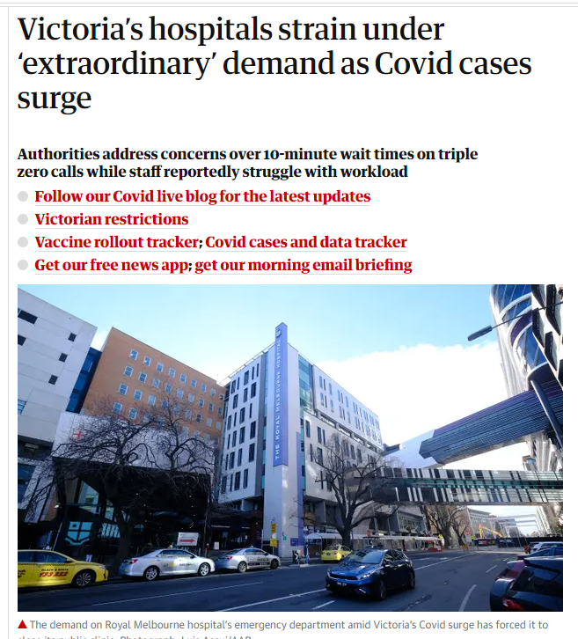
Discuss the motivation behind your research project and the problem you are attempting to solve.
The uncertainty that Coronavirus brings to our lifestyle
Hospitals are running out of resources and unable to plan
Using predictive models to help forecast daily cases
Using these forecast numbers, we can help governments and hospitals plan.

Slide 3
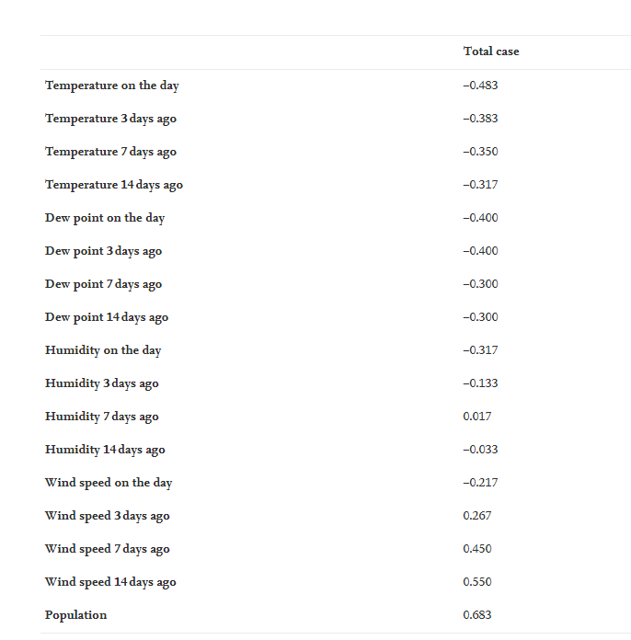
Why is it worth studying?
A lot of predictive models uses only confirmed cases and confirmed deaths
Many papers does not consider any outside factors
Population density and wind speed explains 95% of the transmission rate
Adding in these factors to improve the accuracy of the predictive models
Table 1: This shows the Spearman’s Correlation Coefficients for each factor that was tested by Mehmet Sahin and co

Slide 4
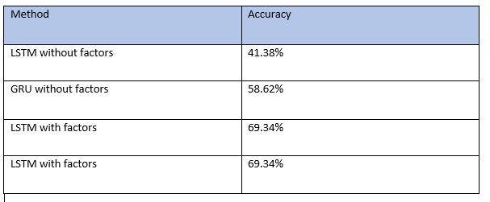
What did you achieve?
Using the encoder decoder method of LSTM and GRU models
Without the two factors, LSTM achieved an accuracy of 41.38% and GRU achieved an accuracy of 58.62%
With the two factors, LSTM achieved an accuracy of 69.34% and GRU also achieved an accuracy of 69.34%

Slide 5
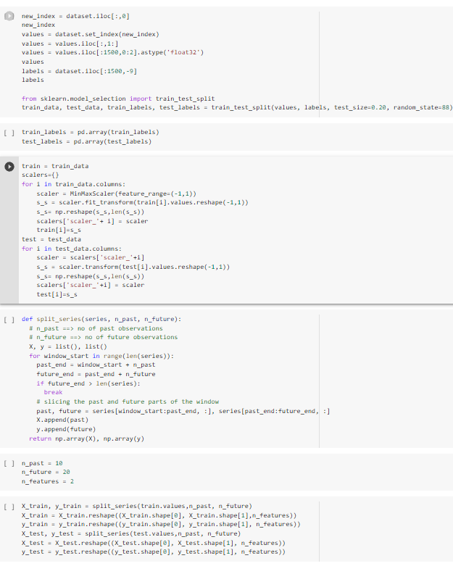
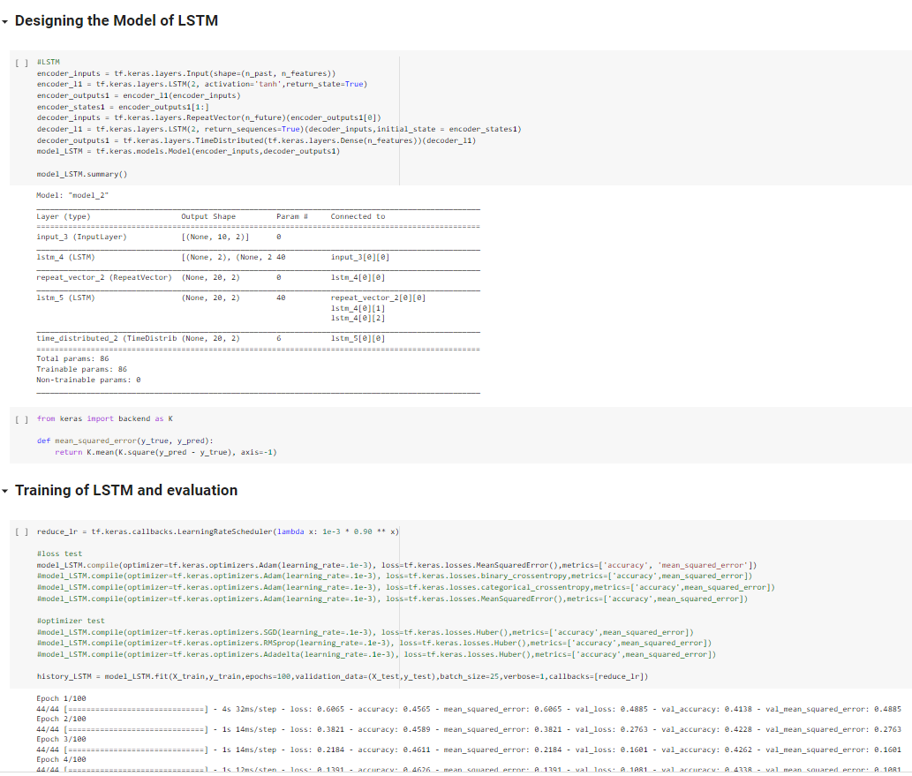
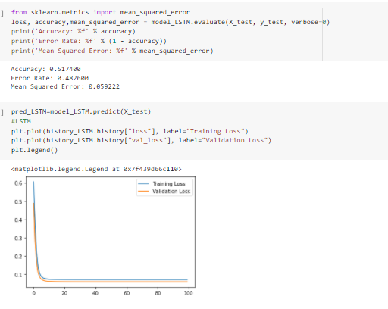
Example of the artefact
Designing the model
Evaluation
Preprocessing

Slide 6

How you can or plan to take it further
To tweak the hyperparameters in the model so that I can run at it’s best
To include any factors in the future that is known to influence the transmission rate of the virus

Slide 7
Thank you very much

